Slide 1
Neigborhood of Istanbul

Slide 2
Introduction
Istanbul is quite a popular tourist and vacation destination for people all around the world. They are diverse and multicultural and offer a wide variety of experiences that are widely sought after. We try to group the neighborhoods of Istanbul respectively and draw insights into what they look like now.

Slide 3
Problem Description
The aim is to help tourists choose their destinations depending on the experiences that the neighbourhoods have to offer and what they would want to have. This also helps people make decisions if they are thinking about migrating to Istanbul or even if they want to relocate neighbourhoods within the city. Our findings will help stakeholders make informed decisions and address any concerns they have including the different kinds of cuisines, provision stores and what the city has to offer

Slide 4
Data Sources
Istanbul neighborhoods geolocation data is required. I used arranged data set including City, Town, neighborhood. Information of Lat Long is retrieved from neighborhood name using geopy arcgis geolocator.
Data Sources : http://www.birkenarayazdiklarim.com/index.php/2020/04/30/turkiyenin-il-ilce-semt-mahalle-koy-veritabani/

Slide 5
GeoPy ArcGIS API
GeoPy ArcGIS API
Geopy is a Python client for several popular geocoding web services. Geopy makes it easy for Python developers to locate the coordinates of addresses, cities, countries, and landmarks across the globe using third-party geocoders and other data sources.
More specifically, we use Geopy to get the geo locations of the neighbourhoods of Istanbul. The following columns are added to our initial dataset which prepares our data.
latitude : Latitude for Neighbourhood
longitude : Longitude for Neighbourhood

Slide 6
Foursquare API Data
We need venues in different neighborhoods of that specific borough. In order to gain that information “Foursquare” is used. Foursquare provides flourish information about venues.Such information includes venue names, locations, menus and even photos. As such, the foursquare location platform will be used as the sole data source since all the stated required information can be obtained through the API.
After finding the list of neighbourhoods, we then connect to the Foursquare API to gather information about venues inside each and every neighbourhood. For each neighbourhood, we have chosen the radius to be 500 meters.
The data retrieved from Foursquare contained information of venues within a specified distance of the longitude and latitude of the postcodes. The information obtained per venue as follows:
Neighbourhood : Name of the Neighbourhood
Neighbourhood Latitude : Latitude of the Neighbourhood
Neighbourhood Longitude : Longitude of the Neighbourhood
Venue : Name of the Venue
Venue Latitude : Latitude of Venue
Venue Longitude : Longitude of Venue
Venue Category : Category of Venue

Slide 7
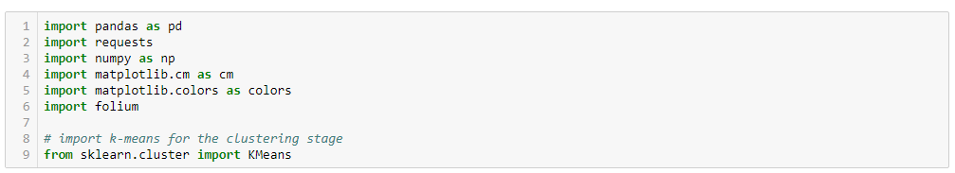
Methodology
I used below libraries.
Package breakdown:
Pandas : To collect and manipulate data in JSON and HTMl and then data analysis
matplotlib : Detailing the generated maps
folium : Generating maps of London and Paris
sklearn : To import Kmeans which is the machine learning model that we are using.
The approach taken here is to explore each of the cities individually, plot the map to show the neighbourhoods being considered and then build our model by clustering all of the similar neighbourhoods together and finally plot the new map with the clustered neighbourhoods. We draw insights and then compare and discuss our findings.

Slide 8
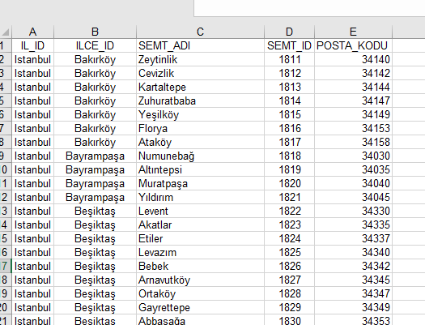
Data Manipulation
I used following information. I manipulated and cleaned data using Excel.
http://www.birkenarayazdiklarim.com/index.php/2020/04/30/turkiyenin-il-ilce-semt-mahalle-koy-veritabani/

Slide 9
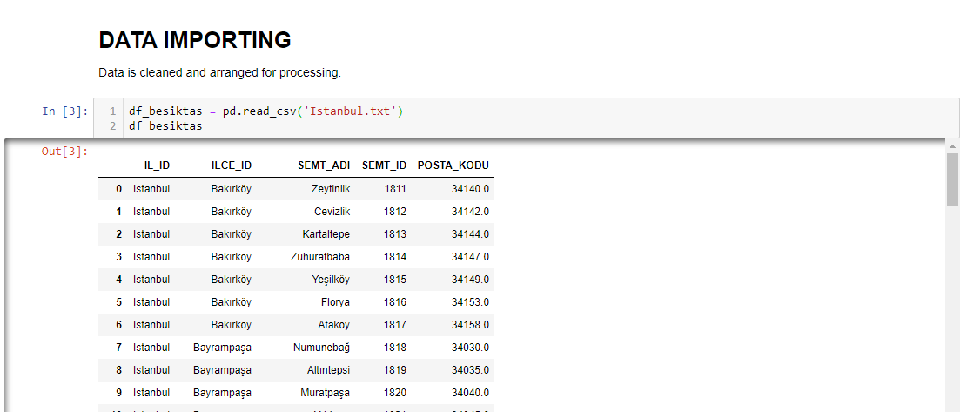
Data Importing

Slide 10
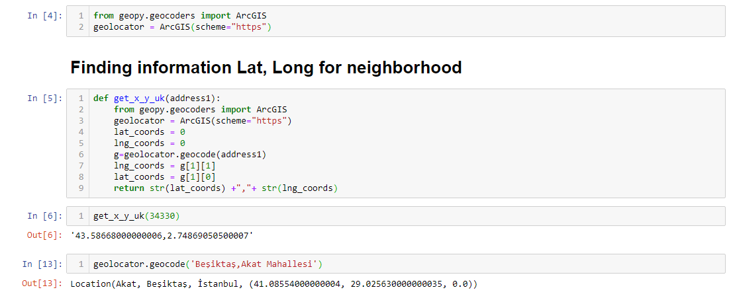
Feature Engineering
Both of our Datasets actually contain information related to all the cities in the country. We can narrow down and further process the data by selecting only the neighbourhoods pertaining to ‘ISTANBUL’.

Slide 11
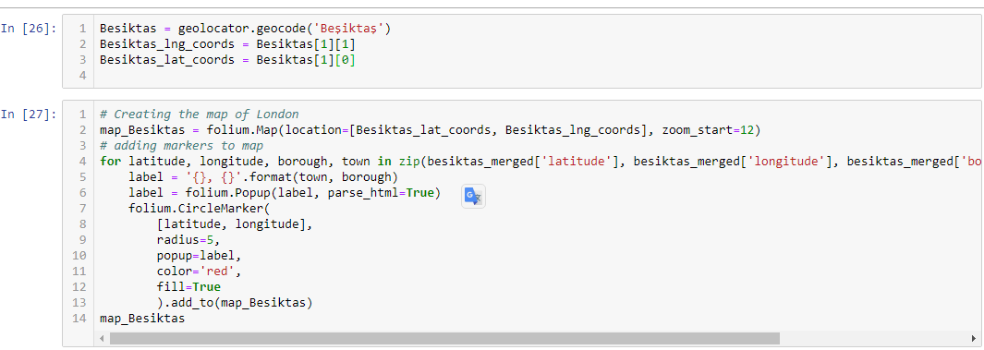
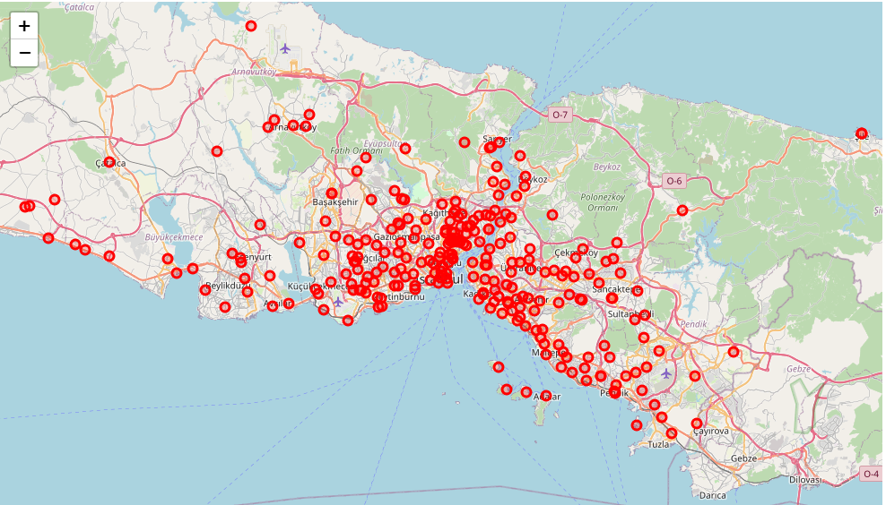
Visualize the Map of Istanbul

Slide 12
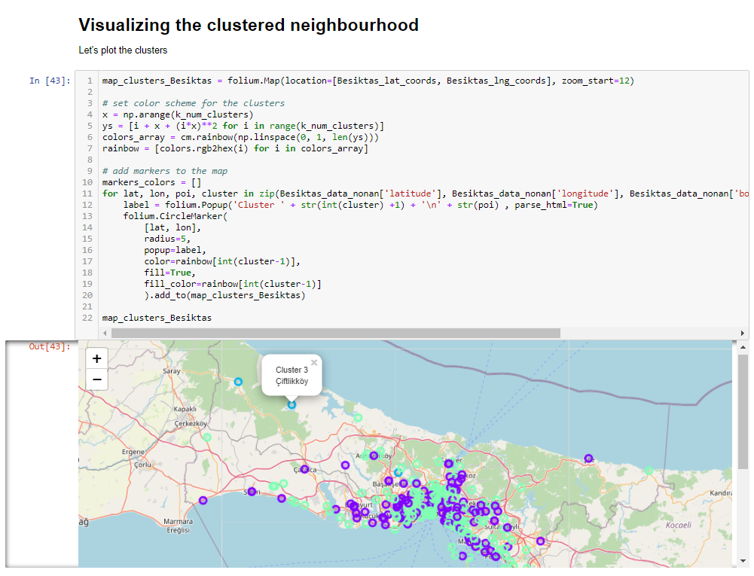
Model Building - KMeans

Slide 13
Results and Discussion
The neighbourhoods of Istanbul are very mulitcultural. There are a lot of different cusines including Syrian, Italian, Turkish and Chinese. Istanbul seems to take a step further in this direction by having a lot of Restaurants, bars, juice bars, coffee shops, Fish and Chips shop and Breakfast spots. It has a lot of shopping options too with that of the Flea markets, flower shops, fish markets, Fishing stores, clothing stores. The main modes of transport seem to be Buses and trains. For leisure, the neighbourhoods are set up to have lots of parks, gyms and Historic sites.
Overall, the city of Istanbul offers a multicultural, diverse and certainly an entertaining experience.

Slide 14
Conclusion
Conclusion
The purpose of this project was to explore the cities of Istanbul and see how attractive it is to potential tourists and migrants. We explored Istanbul based on their postal codes and then extrapolated the common venues present in each of the neighbourhoods finally concluding with clustering similar neighbourhoods together.
We could see that each of the neighbourhoods in both the cities have a wide variety of experiences to offer which is unique in it's own way. The cultural diversity is quite evident which also gives the feeling of a sense of inclusion.

